Slide 1
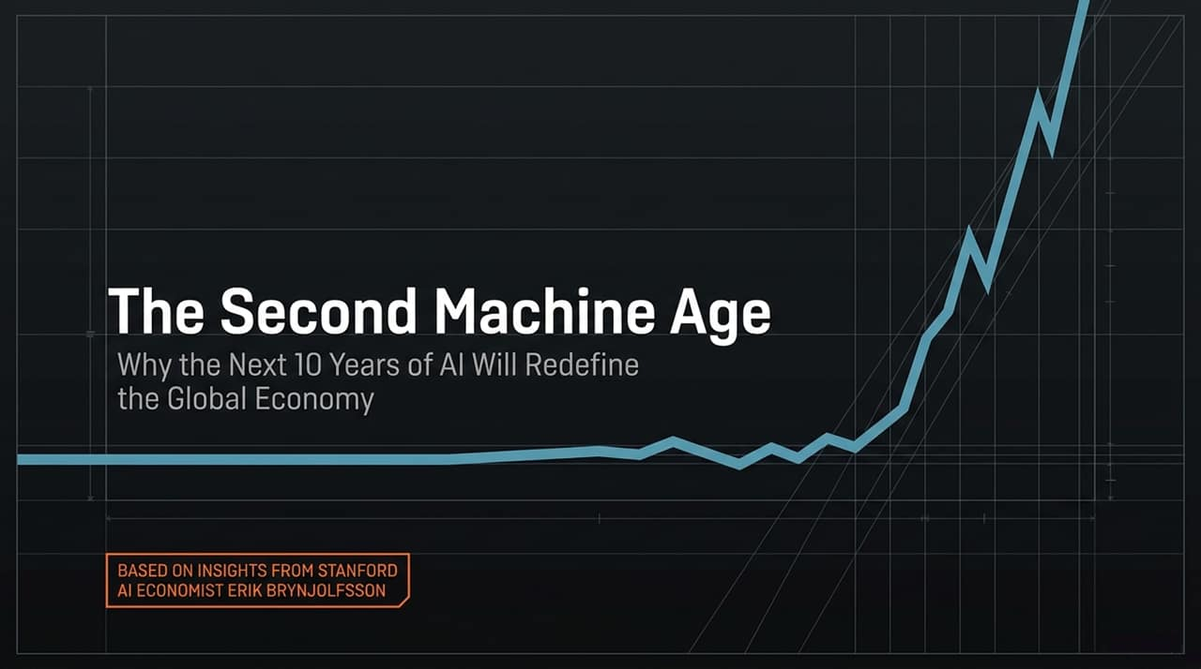
Notes:
Welcome everyone. Today we are exploring "The AI Economic Blueprint," grounded in 30 years of research by Stanford economist Erik Brynjolfsson.
Over the next 10 years, AI will not just increment productivity; it will completely redefine the structure of the global economy.
As we navigate this shift, we face a dual narrative: if managed correctly, this could be the most prosperous decade in human history; if mismanaged, it poses severe risks of inequality and labor disruption.
Today's presentation outlines where value is moving, which jobs are shifting, and how organizations and individuals must adapt.
https://youtube.com/watch?v=72duHF7iZiU

Slide 2
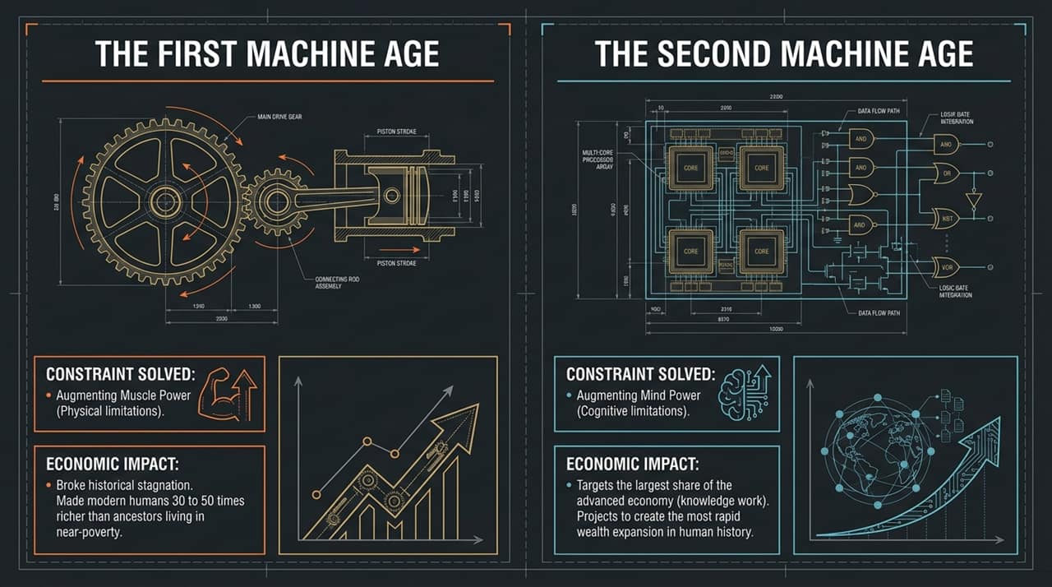
Notes:
To understand AI's macroeconomic impact, we must compare it to the First Industrial Revolution starting around 1800.
The First Machine Age: Overcame physical human limitations by augmenting muscle power through steam engines and mechanical force. It broke thousands of years of economic stagnation, making modern humans 30 to 50 times wealthier than our ancestors.
The Second Machine Age: Solves cognitive limitations by augmenting mind power.
Key Takeaway: Unlike past automation that primarily affected manual labor, AI targets knowledge work—which represents the vast majority of GDP in advanced economies. This makes its speed and wealth-creation potential faster and larger than the First Industrial Revolution.

Slide 3
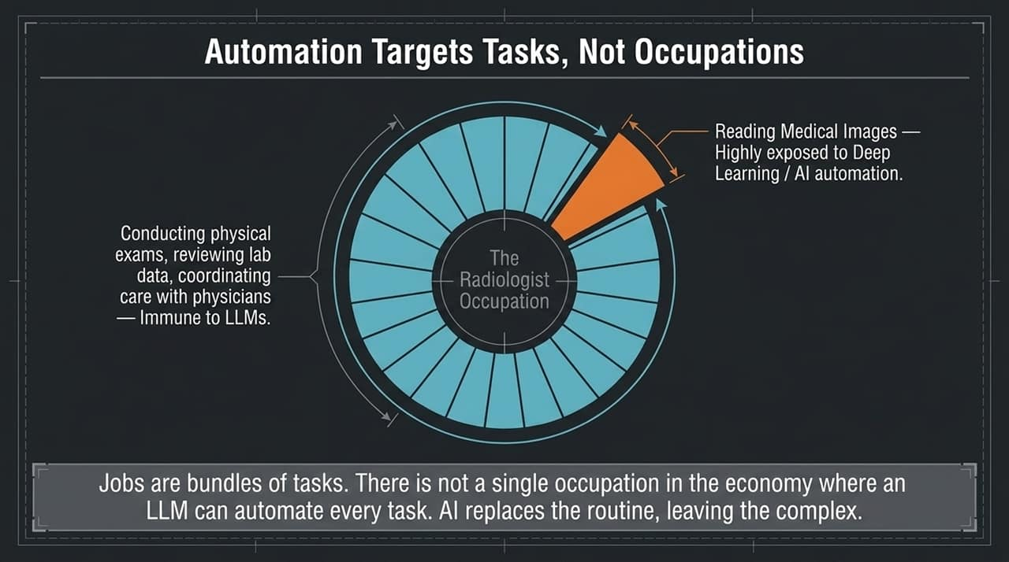
Notes:
A common misconception is that AI replaces entire occupations overnight. In reality, jobs are bundles of distinct tasks.
Take radiologists as the classic example: back in 2017, experts predicted AI would completely eliminate radiologists.
However, reading medical images is only one of roughly 26 tasks a radiologist performs. They also conduct physical exams, review complex lab data, and coordinate care across multidisciplinary teams.
While deep learning heavily automates image reading, LLMs cannot execute physical or complex coordination tasks.
Core Insight: There is almost no job in the economy where AI automates 100% of tasks. AI automates routine, structured execution, leaving complex reasoning, judgment, and physical presence to humans

Slide 4
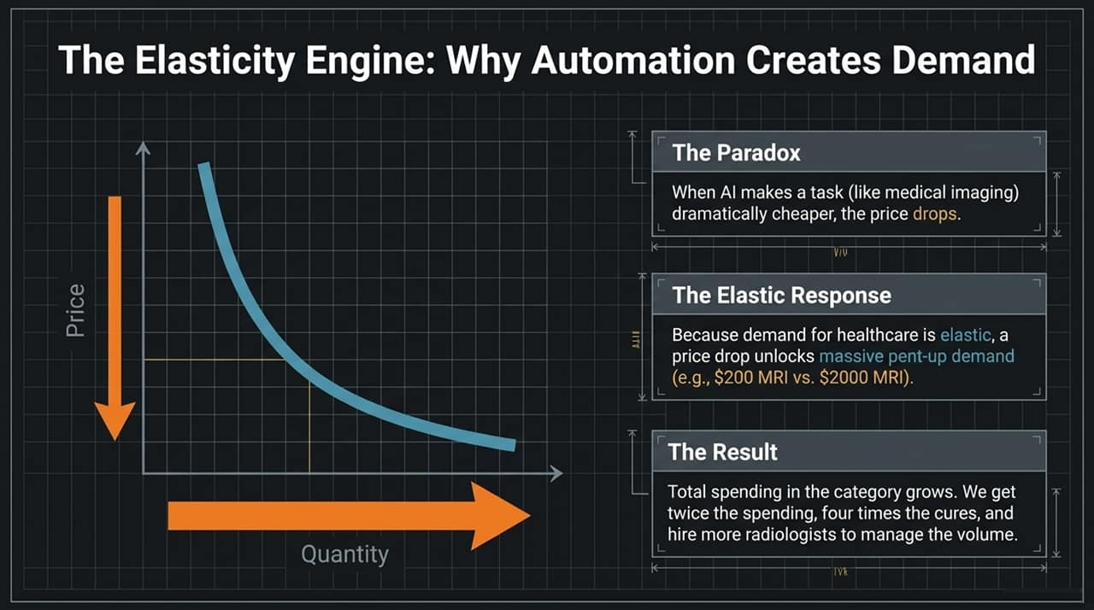
Notes:
If AI automates a task, do we need fewer people? Counterintuitively, the answer is often no due to price elasticity.
The Paradox & Elastic Response: When AI dramatically lowers the cost of a task (like medical imaging), the market price drops. Because demand for healthcare is elastic, a drop in price unlocks massive pent-up demand.
If an MRI drops from $2,000 to $200, patient volume explodes.
The Result: Total spending in that sector actually grows. We end up with more scans, four times as many cures, and a need to hire more radiologists to interpret and manage the massive influx of volume.

Slide 5
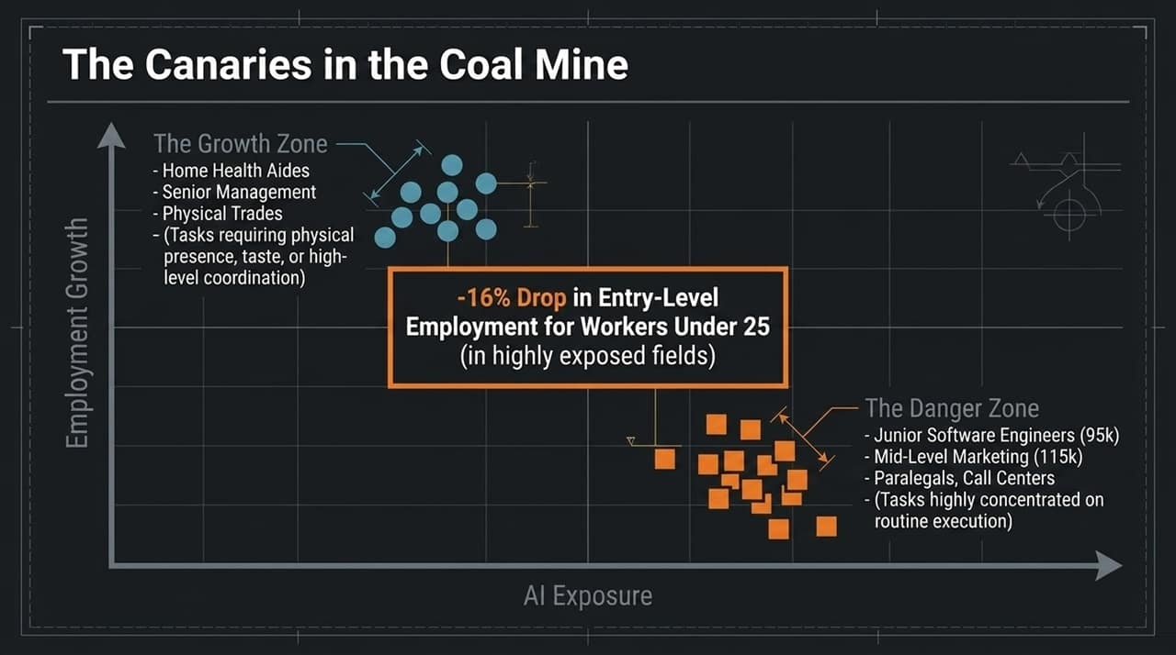
Notes:
Recent research ("Canaries in the Coal Mine") reveals where the labor market is feeling the immediate impact.
The Danger Zone: Entry-level employment for workers under 25 in highly exposed, routine execution fields has seen a 16% drop. Roles like junior software engineers, mid-level marketing coordinators, paralegals, and call-center workers are facing double-digit declines.
The Growth Zone: Conversely, roles requiring high physical presence, human empathy, or high-level strategic coordination (home health aides, senior executives, skilled physical trades) are experiencing job growth.
Takeaway: Disruption isn't a future forecast—it's actively happening right now at the entry-level tier of routine knowledge work.

Slide 6
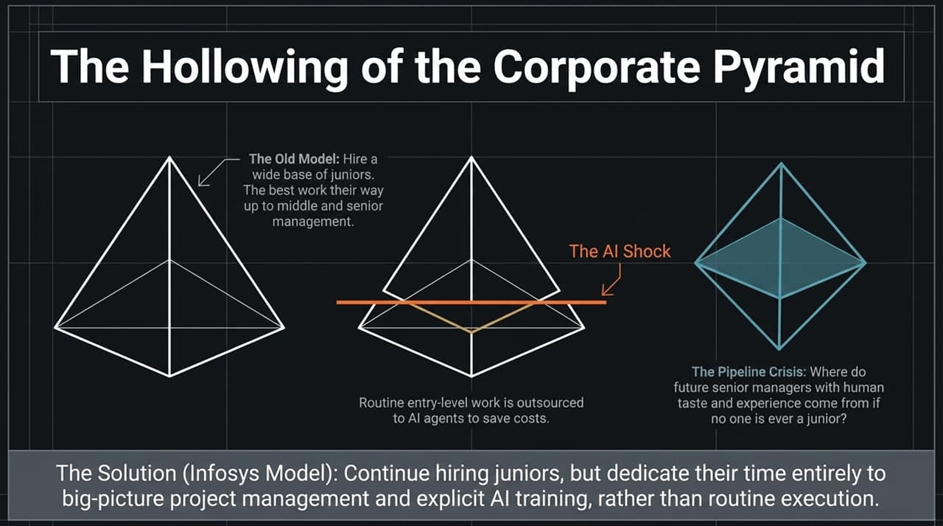
Notes:
The Old Model: Organizations operated as pyramids—hiring a wide base of junior employees who did routine work while learning the industry, with the best ascending to middle and senior management.
The AI Shock: Companies are cutting costs by outsourcing routine execution directly to AI agents.
The Pipeline Crisis: This creates a severe structural problem: if you eliminate junior roles, where do future senior managers get the domain experience and human taste required to lead?
The Solution (Infosys Model): Forward-thinking companies like Infosys are not stopping junior hiring. Instead, they reassign junior workers on day one to manage big-picture projects and supervise AI agents rather than performing manual repetitive tasks.

Slide 7
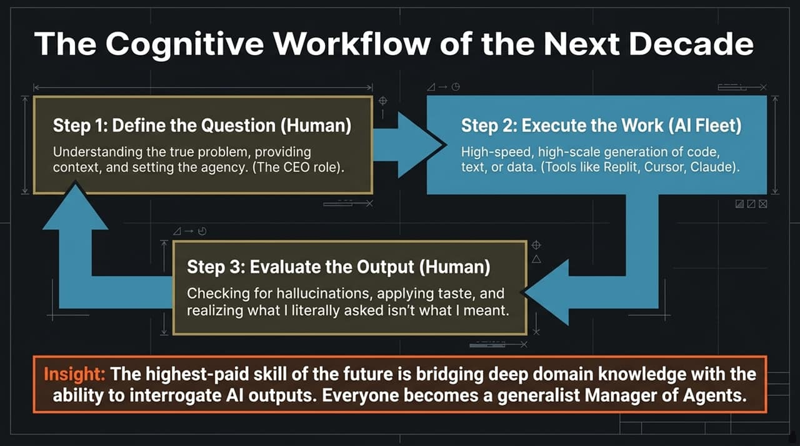
Notes:
Modern work is shifting from "doing execution" to a three-step management workflow:
Step 1: Define the Question (Human): Frame the problem, provide context, and set goals. This requires deep domain context and strategic thinking.
Step 2: Execute the Work (AI Fleet): Deploy specialized AI tools (Cursor, Claude, Replit) to generate code, draft reports, or synthesize data at superhuman speed.
Step 3: Evaluate the Output (Human): Audit for hallucinations, apply taste, and refine. As anyone who uses AI knows, "what you literally asked for often isn't what you actually meant".
Key Takeaway: The highest-paid professional skill of the decade is bridging domain expertise with the ability to orchestrate and interrogate AI agent fleets. Every worker must act like a "CEO of AI Agents".

Slide 8
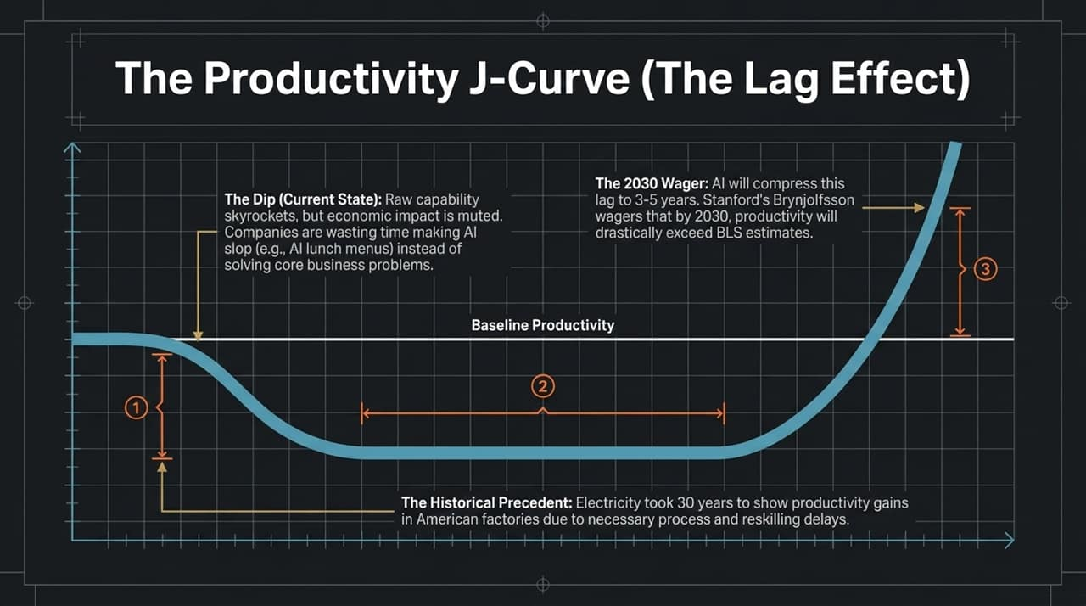
Notes:
People often ask: "If AI is so powerful, why isn't GDP or corporate productivity soaring yet?"
Historical Precedent: When electricity entered American factories, it took 30 years for productivity to show in official metrics. Factories had to completely redesign floor layouts, rewire workflows, and retrain workers before seeing gains.
The Dip / Lag Phase: Today, raw AI capabilities are surging, but companies are stuck making low-value "AI slop" (e.g., using LLMs to format internal lunch menus) rather than redesigning core operational processes.
The 2030 Wager: Brynjolfsson wagers that AI will compress this historical 30-year lag into 3 to 5 years. By 2030, productivity gains will far exceed baseline BLS predictions as business workflows adjust.

Slide 9
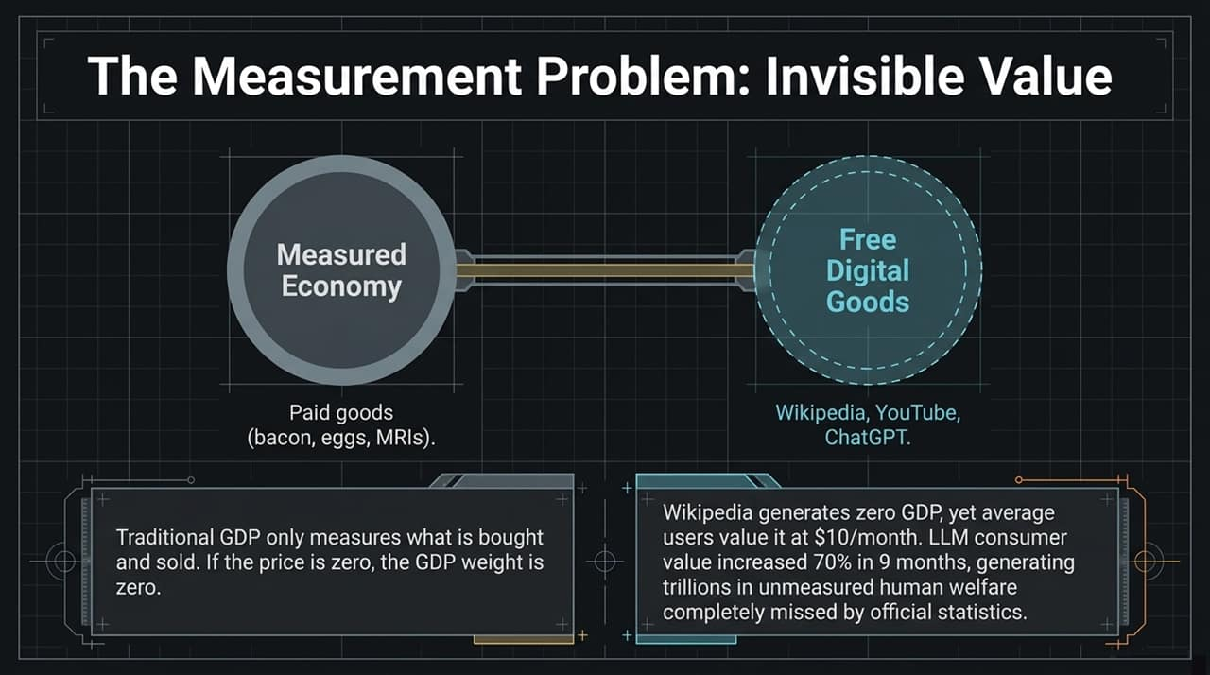
Notes:
Beyond the productivity lag, we face a scoreboard problem. Traditional GDP only tracks market transactions where money changes hands.
The Zero-Price Trap: If a tool is free, its official GDP weight is zero.
Consider Wikipedia: it generates zero GDP, yet the average consumer values access to it at around $10/month.
Consumer value derived from LLM chat interfaces grew by 70% in just nine months, producing trillions of dollars in unmeasured human welfare that remains completely invisible in standard national accounting.

Slide 10
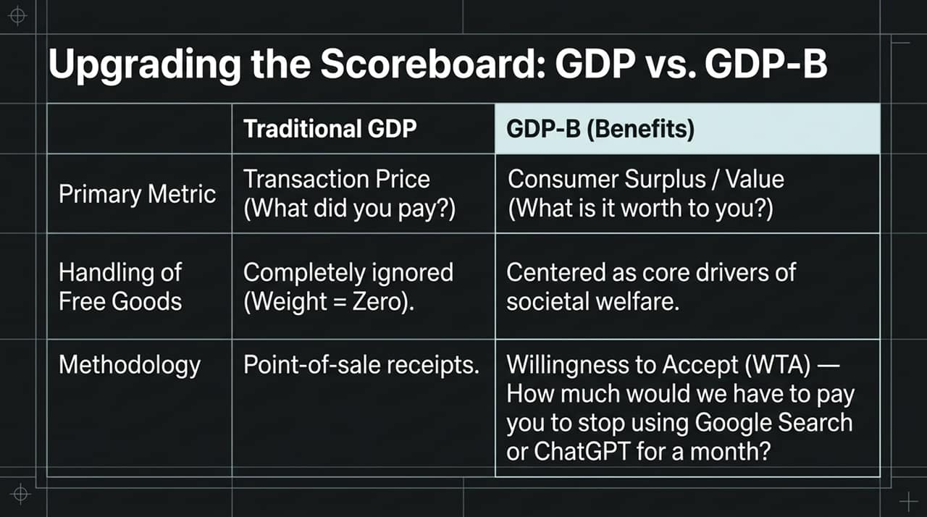
Notes:
To fix the flaw in traditional GDP, economists developed GDP-B (where "B" stands for Benefits).
Methodology Shift: Instead of asking "What did you pay?", GDP-B measures Willingness to Accept (WTA): "How much would we have to pay you to stop using Google Search or ChatGPT for a month?"
While traditional GDP views free software as having zero economic weight, GDP-B places digital utility and consumer surplus at the center of societal health and growth metrics.

Slide 11
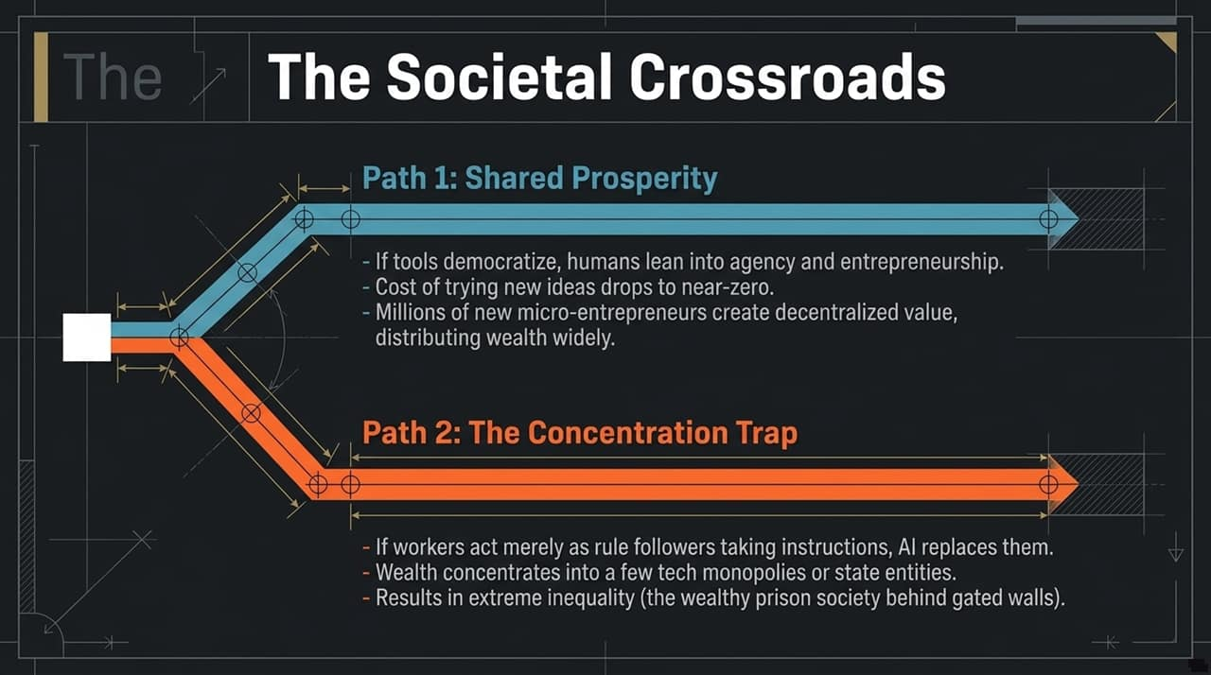
Notes:
The economic impact of AI is not deterministic; we are at a critical fork in the road:
Path 1: Shared Prosperity: Tools become broadly accessible, lowering the cost of experimentation to near zero. Millions of micro-entrepreneurs use AI to build niche companies, distributing economic agency and wealth widely across society.
Path 2: The Concentration Trap: If workers simply act as passive instruction-followers, AI replaces them. Ownership, data, and wealth concentrate into a handful of tech monopolies or state entities, leading to extreme inequality (the "gated community / prison" societal dynamic).
Shaping this future depends on actively encouraging broad entrepreneurship, AI literacy, and proactive transition policies.

Slide 12
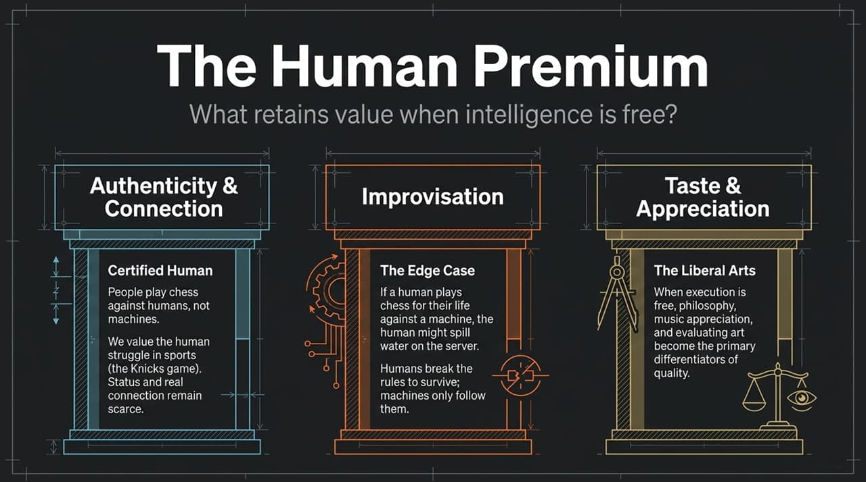
Notes:
When cognitive execution and intelligence become free commodities on demand, what remains scarce and valuable?
Authenticity & Connection: Humans don't watch human chess or live sports just to see flawless execution; we value the shared human struggle and real personal status.
Improvisation & Agency: Machines follow pre-programmed logic; humans break rules, adapt dynamically in novel edge cases, and drive intentional change.
Taste & Appreciation: Liberal arts—philosophy, critical thinking, art, and music appreciation—become core business differentiators. When code or text is free, knowing what is good, ethical, and resonant becomes the ultimate competitive advantage.

Slide 13
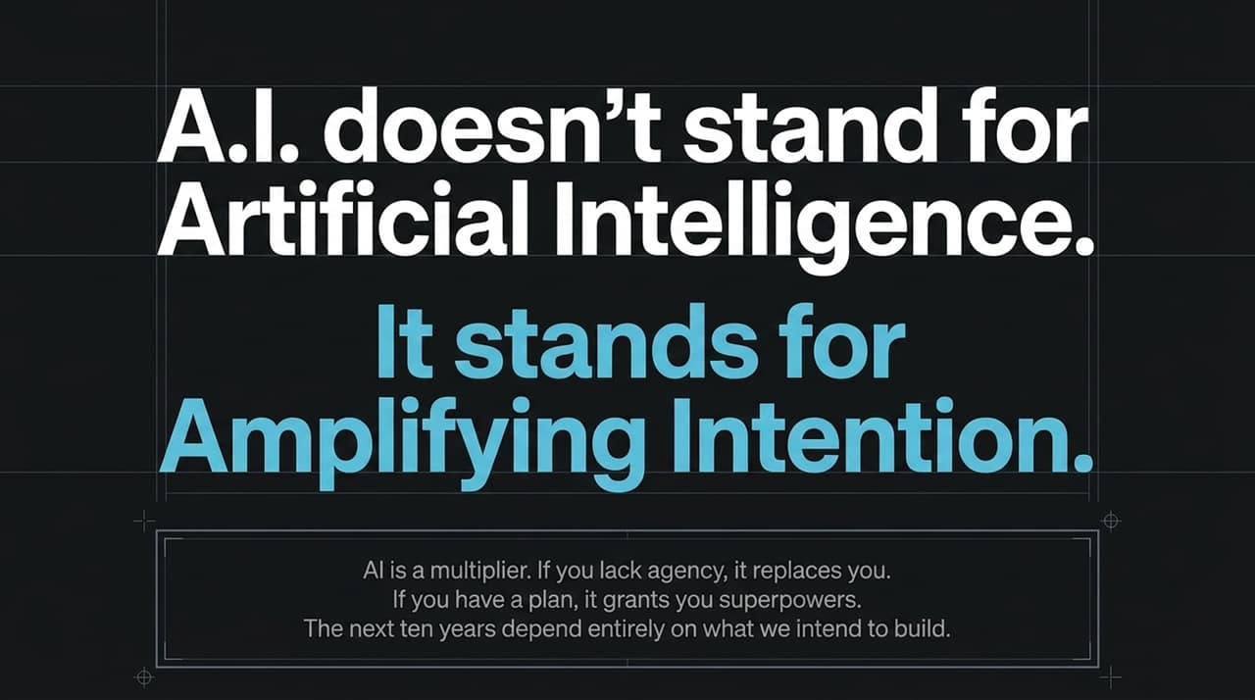
Notes:
The most important mindset shift for teams and individuals: A.I. does not stand for Artificial Intelligence; it stands for Amplifying Intention.
AI acts as a multiplier:
If you have $0$ agency or no clear plan, multiplying by AI still yields $0$—you risk being replaced.
If you possess high agency, a strong vision, and deep domain knowledge, AI grants you superpowers to execute at a scale previously reserved for entire corporations.
The next ten years depend entirely on what we intend to build.

Slide 14
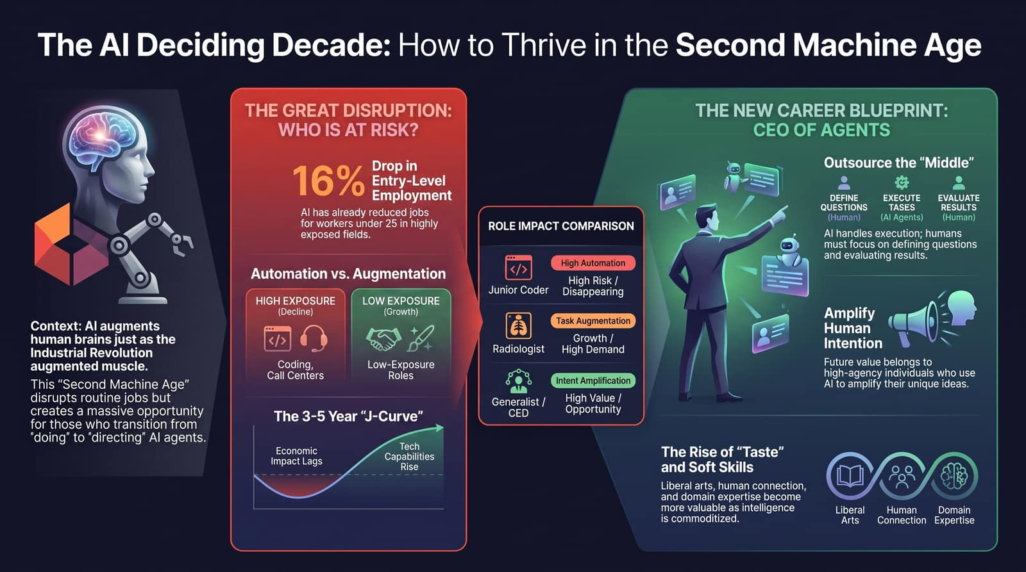
Notes:
To conclude, here is our tactical roadmap for the deciding decade:
Understand the Market Dynamic: Low-exposure/human-centric roles and high-agency generalist positions are growing; routine entry-level roles face contraction.
Bridge the J-Curve: Focus on solving real core business problems with AI, rather than superficial efficiency gains.
Adopt the "CEO of Agents" Mindset: Move away from manual task execution. Shift your focus upstream to defining the right questions and downstream to evaluating results.
Cultivate Taste and Soft Skills: Lean into human connection, domain judgment, and liberal arts discernment.
Use these tools to amplify your unique perspective, adapt quickly, and lead through the Second Machine Age.

